Slide 1
COURSE6 HACKATHON
TITLE : Clustering of Airline Passengers for Specialized Marketing Strategies
Prepared By :
Manisha Mahapatro

Slide 2
AGENDAS OF THE PRESENTATION
Problem Overview
Analysis Process
Recommendation

Slide 3
Problem Overview :
In this hackathon, you will examine the behavior of airlines passengers. The passengers are segmented to the different passenger groups in order to adapt different marketing strategies. The file east west airlines contains information on passengers who belong to an airline’s frequent flier program.
For each passenger the data include information on their mileage history and on different ways they accrued or spent miles in the last year. The goal is to try to identify clusters of passengers that have similar characteristics for the purpose of targeting different segments for different types of mileage offers, thereby increasing airline companies' success rates.

Slide 4
Solution Process :
About Knowing the type of the Dataset (Rows(3999) And Columns (12) , Datatypes)
Preprocessing the dataset ( checking the missing value )
Exploring the dataset finding the correlation of two columns
Analytical Approach (Python) Because It has Easy Structure , Readable Code , Portable And Extensible Programming Language
Technique here we used to do this hackathon is Supervised and Unsupervised Machine Learning

Slide 5
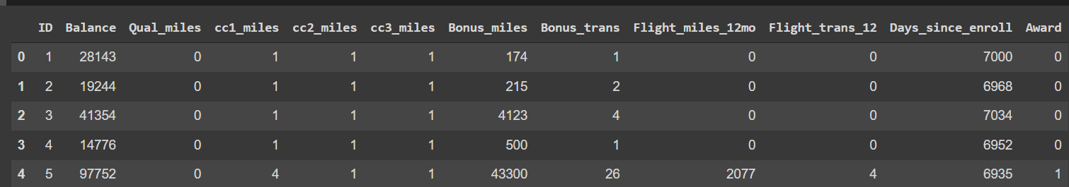
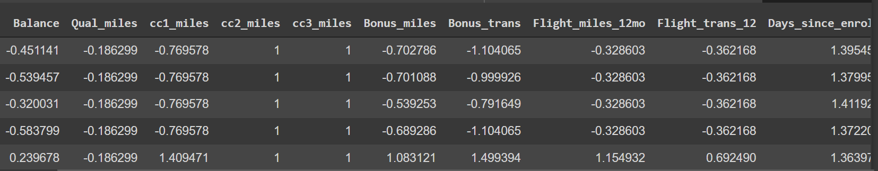
These are the fields included in both supervised and unsupervised learning algorithms
Scaling the data into a certain range

Slide 6
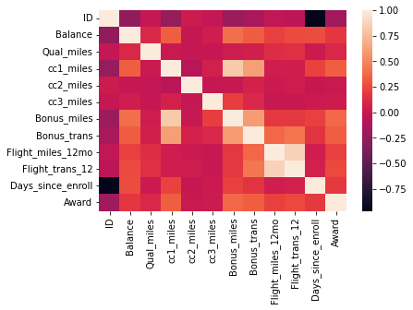
Heat map to check correlation between the fields
The above heatmap is not that much clear to find correlation between the fields so I used df.corr() technique

Slide 7
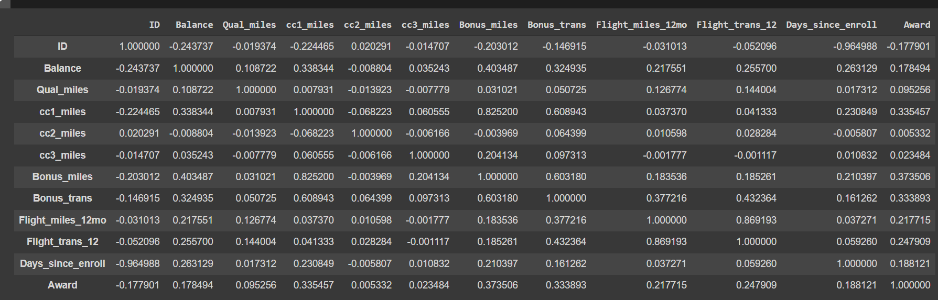
Correlation for each fields
Fields having positive correlation
'Balance', 'Qual_miles', 'cc1_miles', 'Bonus_miles','Bonus_trans','Flight_miles_12mo','Days_since_enroll','Award’

Slide 8
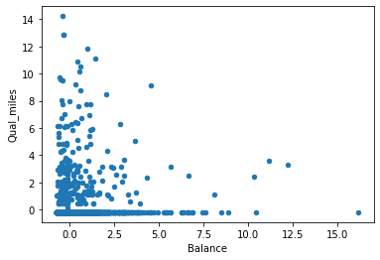
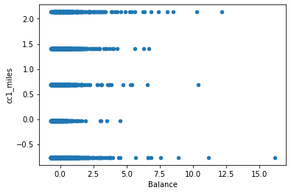
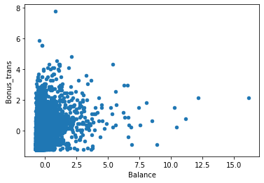
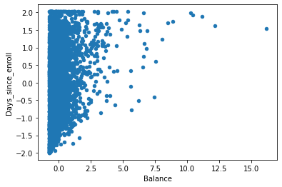
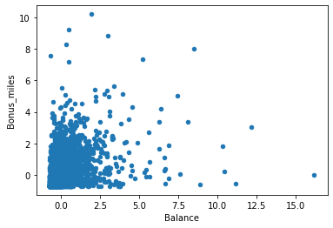
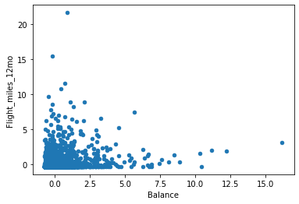
Exploratory Data Analysis (EDA) on the dataset

Slide 9
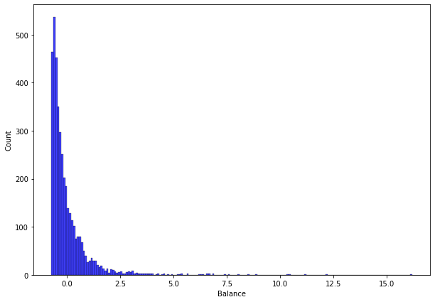
This plot shows the distribution of balance in the customer account
In our dataset it is given that customers having account balance around 4000 to 90000 miles in the account

Slide 10
Tabular representation of silhouette scores
clusters | silhouette_score
2 | 0.3363941920693057
3 | 0.3233450467665015
4 | 0.33282105346834956
5 | 0.2813621091829875
6 | 0.2744212966192579
7 | 0.2467750065106076
8 | 0.2571829170657478

Slide 11
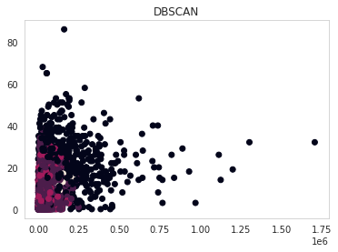
Hyper parameters for eps= 0.8 and min_samples= 12
DBSCAN model gives us 6 clusters.
The Silhouette Score for Cluster 6 is 0.26922.

Slide 12
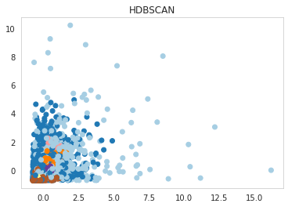
For min_sample_size: 15, the No. of clusters formed are 6 and
Number of outliers are 929.
HDBSCAN with this has the least amount of outliers.
The Silhouette Score for Cluster 6 is 0.2744212966192579

Slide 13
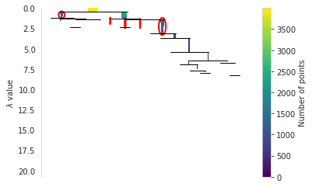
Condensed tree for min_cluster_size=6, min_samples = 15
In the above condensed tree we can clearly see that there are 6 clusters

Slide 14
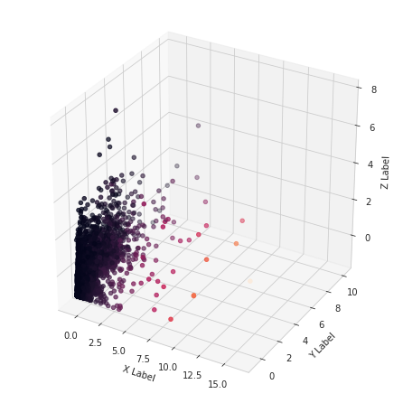
3D plot for Balance ,Bonus miles ,Bonus trans as x,y,z axis

Slide 15
Silhouette Scores after Dimension Reduction
clusters | silhouette_score
2 | 0.4619540223201434
3 | 0.46670689928316483
4 | 0.4188892996133697
5 | 0.3704396057234489
6 | 0.4147795499022503
7 | 0.33182155241891986
8 | 0.3355477934881762

Slide 16
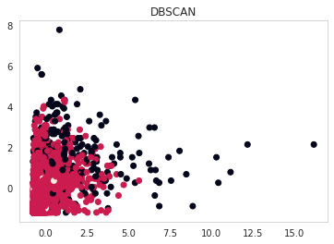
For min_sample_size: 60, the No. of clusters formed are 3
DBSCAN with this has the least amount of outliers.
The Silhouette Score for Cluster 3 is 0.46670689928316483

Slide 17
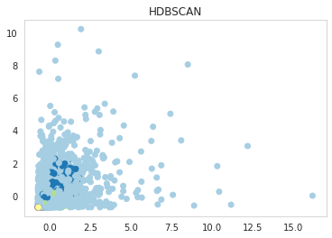
For min_sample_size: 60, the No. of clusters formed are 3 and No.of outliers are 1740.
HDBSCAN with this has the least amount of outliers. The Silhouette Score for Cluster 3 is 0.46670689928316483

Slide 18
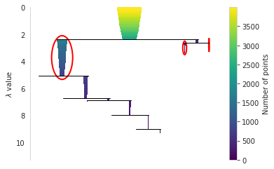
Number of clusters formed are 3 as we can see in the above condensed tree

Slide 19
Interpretation without Feature Reduction
For eps= 0.8 and min_samples= 12, DBSCAN model is giving us 6 clusters. The Silhouette Score for Cluster 6 is 0.26922044689846153
For min_sample_size: 15, the No. of clusters formed are 6 and No.of outliers are 929. HDBSCAN with this has the least amount of outliers. The Silhouette Score for Cluster 6 is 0.26922044689846153
Interpretation with Feature Reduction
For min_sample_size: 60, the No. of clusters formed are 3 in DBSCAN . The Silhouette Score for Cluster 3 is 0.46670689928316483
For min_sample_size: 60, the No. of clusters formed are 3 and No.of outliers are 1740. HDBSCAN with this has the least amount of outliers. The Silhouette Score for Cluster 3 is 0.46670689928316483

Slide 20
Observation for both DBSCAN and HDBSCAN with and without Dimension Reduction
 | WITHOUT | DIMENSION REDUCTION | WITH | DIMENSION REDUCTION
 | Cluster | Silhouette Score | Cluster | Silhouette Score
DBSCAN | 6 | 0.26922044689846153 | 3 | 0.46670689928316483
HDBSCAN | 6 | 0.26922044689846153 | 3 | 0.46670689928316483

Slide 21
Recommendation
Final conclusion of Unsupervised Learning
After Feature Reduction DBSCAN and HDBSCAN model is the Preferred model

Slide 22
Supervised Learning
Independent variable(x)
'Balance', 'Qual_miles', 'cc1_miles', 'cc2_miles', 'cc3_miles','Bonus_miles', 'Bonus_trans', 'Flight_miles_12mo', 'Flight_trans_12','Days_since_enroll'
Dependent target variable(y) 'Award’
Splitting the data into train and test data
into 80 : 20 ratio
Creating model
Fitting the model
Predict the model
Finding accuracy
Steps which repeats in every model

Slide 23
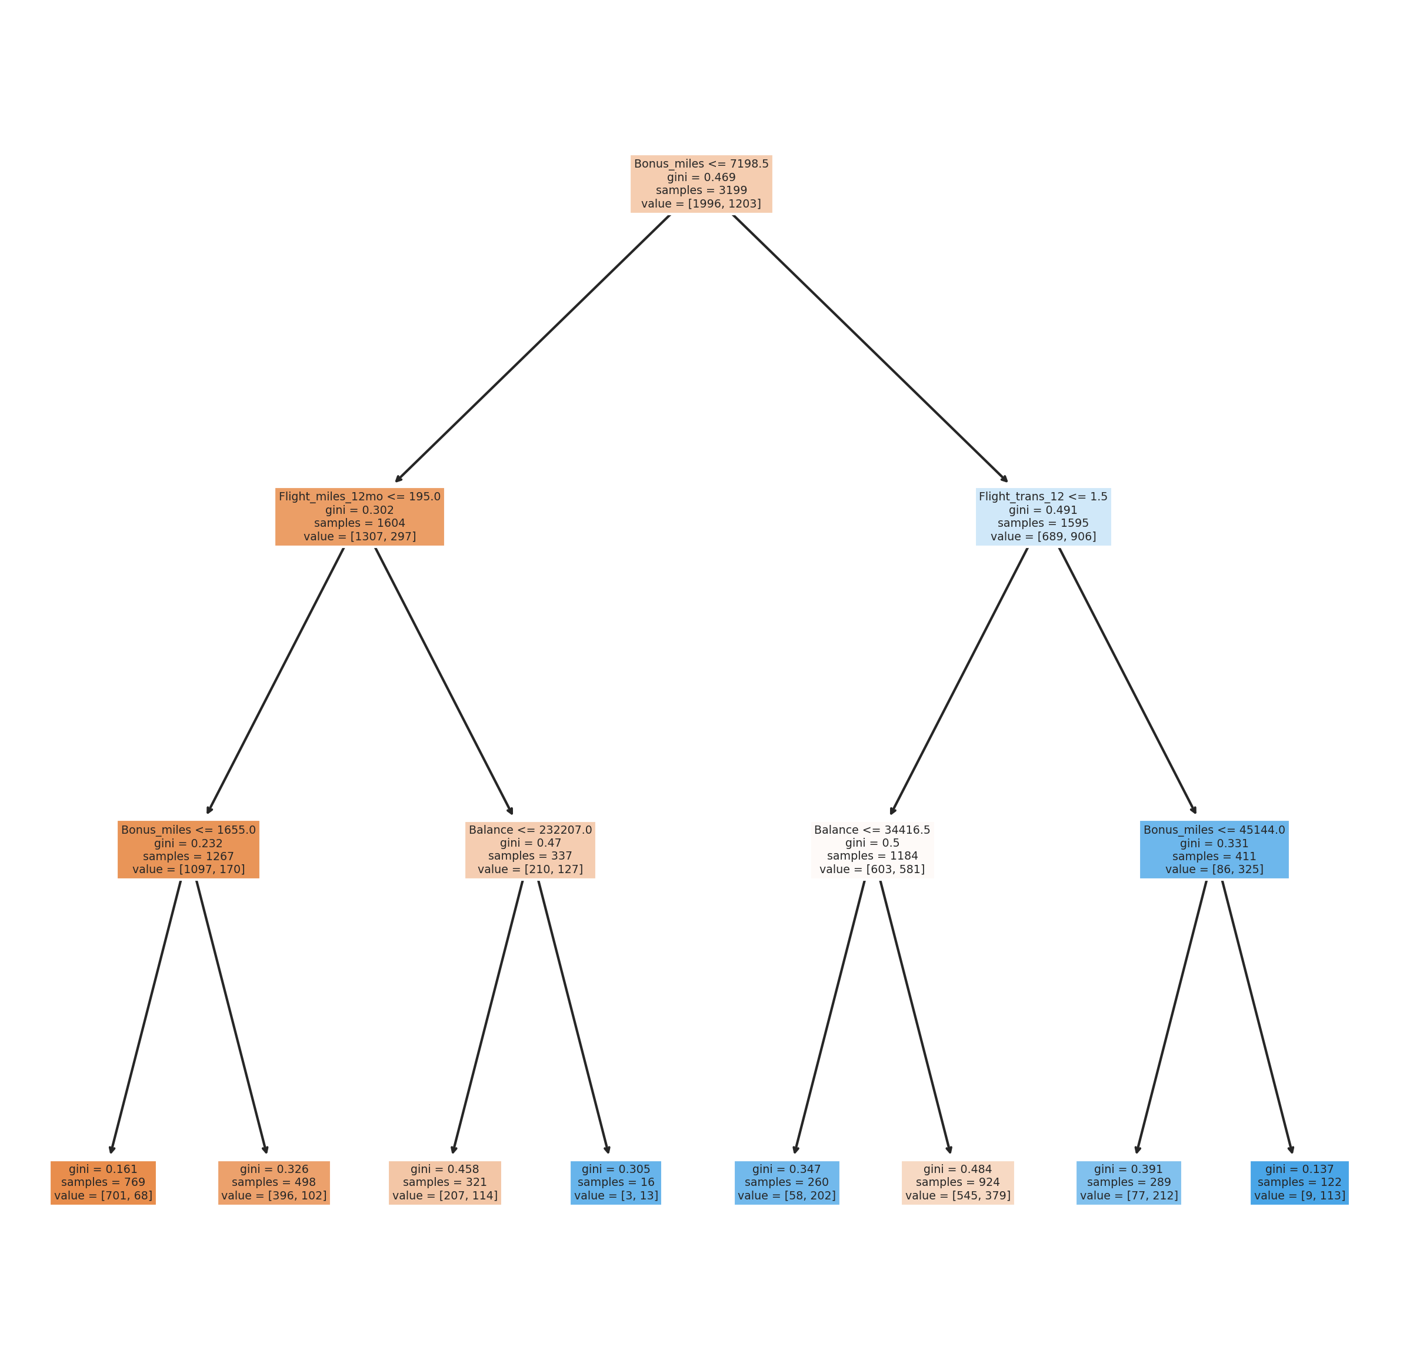
Supervised Learning (Decision Tree)

Slide 24
Accuracy scores of all the supervised clssimodel
Model | Accuracy
K-Neighbor | 72.5%
Naïve Bayes | 72.125%
Decision Tree | 74.75%
Random forest | 78.875%
AdaBoost | 76.625%
Stacking | 74%

Slide 25
Conclusion Of Supervised Learning
By comparing all the supervised models , we get to know that RANDOM FOREST classifier is giving high accuracy ( 78.875%)
From confusion matrix [[451 71]
[ 98 180]]
True positive
False positive
False negative
True negative
Accuracy Score : True Positive + True Negative
451+180
800
=
X 100 = 78.8
: (Total Records)

Slide 26
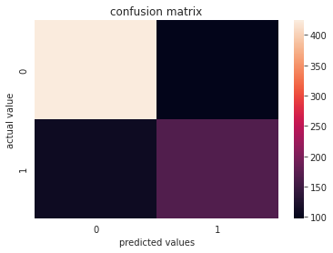
Random Forest conufusion matrix
True positive
False positive
451
71
98
98
180
98
False negative
True negative

Slide 27
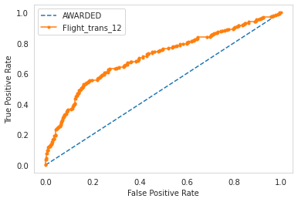
Plot of ROC_AUC_curve for RANDOM FOREST
The area graph shows who are awarded
Area under curve determines the accuracy quality of the model
ROC-AUC curve works good for the Binary classification
When area under the curve will increase accuracy of the model also will increase
ROC score is 0.7557

Slide 28
Recommendation
Final Conclusion of Supervised learning
For this dataset RANDOM FOREST is best with 79 percent accuracy

Slide 29
conclusion
After Feature Reduction DBSCAN and HDBSCAN model is the Preferred model
For this dataset RANDOM FOREST is best with 79 percent accuracy

Slide 30


